Slide 1
UI Design Principles
CSC 324: Software Development and Design

Slide 2
Announcements
Upcoming events:
CS table: starts again next week!
CS extras: "The Quest for Transparency and Accountability in the Online Data Ecosystem"
Thursday @ 4:00 PM, Science 3821
Upcoming deadlines:
Group project:
Sprint 1.3 begins today (review & planning during group work today)
MVP is due next Wednesday!
This Friday: tech tutorial development
Required for the self-learning developer competency
1-on-1s (B-side): updates on competency targets for sprint 1

Slide 3
User interface design principles
Memory
How do people learn and recall information?
Visualization
How do people (visually) process and perceive information?
Mental and physical limits
What constraints do people have that constrain our designs?

Slide 4
UI Design Example
Crane Controls

Slide 5
Crane Controls

Slide 6
Short-term vs. long-term memory
Short-term (working memory)
Easy to access
Finite in size (5–12 items), mitigated by chunking
Short duration (seconds to a few minutes)
Long-term memory
Difficult to access, overcome by rehearsal
Effectively limitless in size and duration (to the best of our knowledge)
Interfaces ought to:
Provide short-term reminders for functionality
Facilitate long-term learning

Slide 7
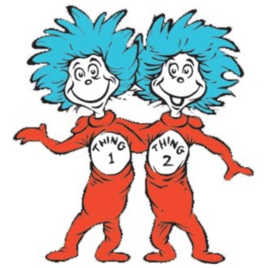
Dual Process Theory
Mind = two systems
“System 1”: unconscious, automatic, “emotional.”
“System 2”: conscious, deliberate, “rational.”
Unconscious
=
easy
Conscious
=
hard
Notes:
The dual process theory for cognition states that we can think our mind as…
…two separate systems.
The first system, commonly called ”System 1” in the literature is our unconscious mind. It is responsible for automatic, autonomous action.
In contrast, the second system, “System 2” is our conscious mind, responsible for deliberate, reason-based action. You will see in the literature these systems referred to as the “emotional” and “rational” minds respectively although I find these a bit misleading since the words imply that System 1 is responsible for, in quotes, irrational, emotional behavior, in the pejorative sense. A better view of the systems come from the observation that most of our actions, e.g., breathing, blinking, activating muscles to move a limb, are all automatic in nature and thus governed by System 1. Ironically, while System 2 is the thoughtful, “conscious” process, it is less responsible for the sum of our actions.
For our purposes, we can draw a distinction between these two systems for the purposes of usability. Anything that system 1 tackles is easy to our user, and anything that system 2 tackles is hard. This seems like a gross exaggeration, but think about it: system 1, by definition, handles automatic function. Automatic function for a user is, by definition, just that, it happens without conscious effort or thought. In contrast, system 2 governs thinking and deliberation. Anything that system 2 handles will be noticed by a user and perceived to take conscious thought.

Slide 8
The Stages of Competence
”I know what I don’t know.”
“I know, and I don’t have to think about it.
”I know, but I have to think about it.”
“I don’t know what I don’t know.”
Unconscious incompetence
Conscious incompetence
Conscious
competence
Unconscious
competence
Notes:
How does learning factor into conscious and unconscious thought? We observe that as a person becomes skilled at a task, they move between unconscious to conscious reasoning and then, somewhat counterintuitively, back to unconscious reasoning again! Let’s consider a timeline of a person’s development of a skill.
Initially, they begin in the unconscious incompetence phase.
They both don’t know how to perform the task and they don’t know that fact. This state may be benign in the sense that the person is simply not able to perform the task and not sure how to proceed forward. However, being in this state may be also lead to a false sense of expertise, a phenomena called the Dunning-Kruger effect.
Next a person enters the conscious incompetence phase.
A person progress by realizing their own shortcomings and striving to get better. They may be succeeding at the task at times, but it is rarely and with great mental effort.
Eventually the person enters the conscious competence phase…
… where they are able to to perform the skill consistently but with some mental effort.
Finally, the person enters the unconscious competence phase.
They are proficient enough that the skill comes automatically to them and without much, if any, conscious effort.

Slide 9
Confidence and Competence
Also enjoyment!
Confidence
But teaching…
Unconscious incompetence
Conscious incompetence
Conscious
competence
Unconscious
competence
Notes:
With this timeline established, let’s now consider a person’s confidence in their skills as they progress through these phases. Let’s consider the example of a person learning a musical instrument.
In the unconscious incompetence phase, a person is not even aware of their shortcomings. I like to think of this as the “honeymoon” phase. In the context of learning a musical instrument, initially you will find great joy in simply making noise. Maybe you learn some of your favorite pop songs by ear or by buying a book, but your knowledge of music and the potential for your instrument is limited.
Some people end their journey in music in this first phase. Others get “bit by the bug” and want to take their skills to the next level. They do research, they start taking lessons, they enter the conscious incompetence phase where they become faced with the reality that they weren’t as good as they once thought! Their confidence plummets as a result. If the person didn’t quit once they learned a few pop songs, it is very likely they’ll quit once they are faced with the reality of the practice grind.
However, some people push ahead. They get to the point where they are consciously competent in their instrument. They can do pick up new tunes quickly, but it takes them some effort to rehearse them all. But as a result, their confidence goes up.
Eventually, they reach the point where their instrument is an extension of their being. They can hear musical ideas and then translate them into their instrument without conscious effort. As a result, their confidence is high—playing music is as guaranteed as breathing is to these individuals.
As designers, understanding the trajectory of a person’s confidence as they learn a new skills is important because it translates to their enjoyment of the skill. Learning requires time and effort, and that work may deter people from using a tool that requires them to invest too much time up front to gain tangible benefits.
As an aside, teaching almost follows this curve. People that are unconsciously incompetent are particularly scary due to the Dunning-Kruger effect: they tell people the wrong things but sound really confident about it. Interestingly enough, though, the problem arises when we reach the unconscious competence phase. Someone for whom a skill is second nature is not necessarily the best teacher of said skill! This is an explanation of the phrase “well the proof of this fact is intuitively obvious” in mathematics. For a person who has mastered the skill of mathematical proof, it is genuinely intuitively obvious. However, they have forgotten with their unconscious competence that others may not feel the same way.

Slide 10
UI design in review
Memory and learning
Short- and long-term memory
System 1 & 2 cognition
Unconscious/conscious (in-)competence
Visual perception
Gestalt principles
Physical and emotional realities
Fitts's law
Responsiveness
Multitasking
Cognitive biases

Slide 11
Gestalt Principles
Psychological principles for how human's perceive visual information
An interface is more than the sum of its parts!
Proximity: group things together that are close to each other in space.
Similarity: group things together that look alike.
Continuity: fill in discrete structures into continuous structures automatically.
Closure: Automatically close structures that are open.
Symmetry: Reduce complexity by seeking out symmetry.
Figure/ground: Recognize elements that are in the foreground versus the background.

Slide 12
"Reading is Unnatural"
Humans are "prewired" to learn a spoken language, but not to learn to read (Designing with the Mind in Mind, Johnson)
Reading amounts to training our visual system to understand patterns of symbols
Primarily occurs in a top-down (feature) manner with bottom-up (context) information assisting
Optimizing for reading is important!
Vocabulary
Fonts
Color
Etc.

Slide 13
Activity: Gestalt in VSCode
Where do you see Gestalt at play in VSCode?
Proximity: group things together that are close to each other in space.
Similarity: group things together that look alike.
Continuity: fill in discrete structures into continuous structures automatically.
Closure: Automatically close structures that are open.
Symmetry: Reduce complexity by seeking out symmetry.
Figure/ground: Recognize elements that are in the foreground versus the background.

Slide 14

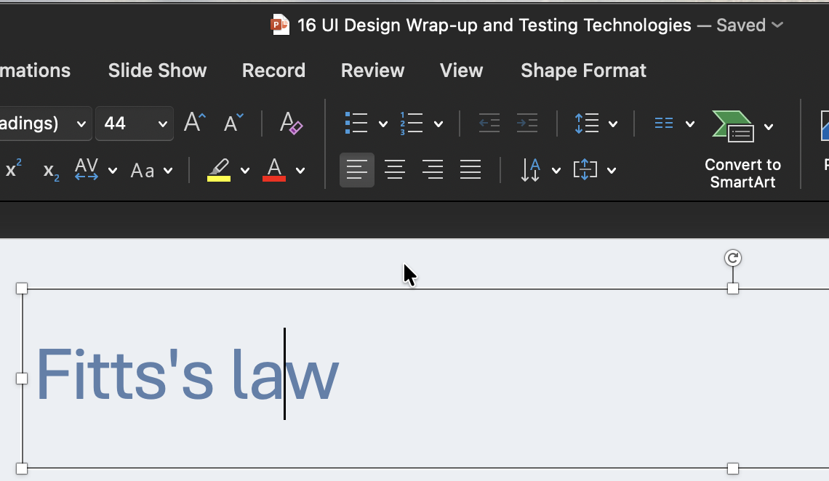
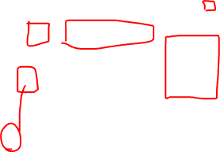
Fitts's law
Time taken to move to a target is:
Proportional to distance (D)
Inversely proportional to size (W)
How do we design with Fitts's law in mind?

Slide 15
Responsiveness
<0.1 seconds = limit of "instantaneous" effects
Perception of direct manipulation
<1 second = limit of the user's flow of thought
Perception of freely navigating the UI
<10 seconds = limit of the user's attention span
Perception of system working to accomplish a task
What are examples of each of these tiers of responsiveness in interfaces that you have used?
https://www.nngroup.com/articles/response-times-3-important-limits/

Slide 16
Multitasking
...is a myth!
Try it out: https://armorgames.com/play/4369/multitask
What do we do when we "multitask?"
Context switching = "goal shifting" + "rule activation
Costs of context switches add up!
https://www.apa.org/topics/research/multitasking

Slide 17
Cognitive biases
Recall system one & two thinking:
System one is subconscious, automatic, and “emotional”.
System two is conscious, deliberate, and “rational”.
Cognitive biases: when system one makes decisions that require more rational, deliberate thought
Two biases relevant to interface design:
Loss aversion/four-fold pattern
Framing effect
How can we use these biases productively?
Help System two override System one.
Exploit System one to support System two.

Slide 18
Loss aversion/the four-fold pattern
 | High-probability | Low-probability
Gains | Betting with the odds Risk averse (Fear of disappointment) | Playing the lottery Risk seeking (Hope of large gains)
Losses | "Hail mary"s Risk seeking (Hope to avoid loss) | Buying insurance Risk averse (Fear of large loss)

Slide 19


The framing effect
Our decisions are influenced by how information is portrayed.

Slide 20
Group Work Time
Keep going!

